Slide 1
MALLAREDDY ENGINEERING COLLEGE
MINI PROJECT
HEART DISEASE PREDICTION USING DEEP LEARNING
A.DEEPAK 22J41A67D2
K.HARISH 22J41A67F6
D.SAIKIRAN 22J41A67E3
P.THARUN 23J45A6717

Slide 2
Abstract
This presentation explores the prediction of heart disease using machine learning techniques.
We aim to analyze various risk factors and develop a predictive model that can assist healthcare professionals.
Through this study, we hope to enhance early detection and intervention strategies for heart disease patients.

Slide 3
Introduction
Heart disease remains one of the leading causes of death globally, necessitating effective predictive models.
Early prediction can significantly improve patient outcomes and reduce healthcare costs associated with late interventions.
This study focuses on utilizing data-driven methods to identify key indicators and build a reliable prediction model.

Slide 4
Objectives
The primary objective is to develop a robust algorithm for predicting heart disease risk based on patient data.
We aim to identify significant risk factors that contribute to heart disease development and progression.
Ultimately, the goal is to create a tool that can be easily integrated into clinical practice for risk assessment.

Slide 5
Hardware Requirements
A standard laptop or desktop computer with a minimum of 8GB RAM is required for data processing.
A graphics processing unit (GPU) may be beneficial for training complex machine learning models efficiently.
Adequate storage space, at least 500GB, is essential for handling large datasets effectively.

Slide 6
Software Requirements
Python will be the primary programming language used for data analysis and model development.
Libraries such as Scikit-learn, Pandas, and NumPy will facilitate machine learning and data manipulation tasks.
Jupyter Notebook or Anaconda can be utilized for an interactive coding environment and seamless package management.

Slide 7
Data Collection
Datasets will be sourced from publicly available medical repositories and health organizations.
Key attributes such as age, cholesterol levels, blood pressure, and family history will be included in the dataset.
Data preprocessing steps will be implemented to handle missing values and normalize the dataset for analysis.

Slide 8
Proposed Methodology
The methodology consists of data exploration, preprocessing, and the application of machine learning algorithms.
Various algorithms, including Logistic Regression, Decision Trees, and Random Forests, will be evaluated for accuracy.
The model will be validated using cross-validation techniques to ensure reliability and robustness of predictions.

Slide 9
Model Evaluation
Model performance will be assessed using metrics such as accuracy, precision, recall, and F1-score.
A confusion matrix will be employed to visualize the model's predictive capabilities and identify misclassifications.
By comparing different algorithms, we aim to select the best-performing model for heart disease prediction.

Slide 10
Future Work
Future research will focus on enhancing model accuracy through hyperparameter tuning and feature engineering.
Incorporating real-time data collection methods can further improve predictive capabilities in clinical settings.
Collaboration with healthcare professionals will be essential to validate the model’s effectiveness in real-world scenarios.

Slide 11
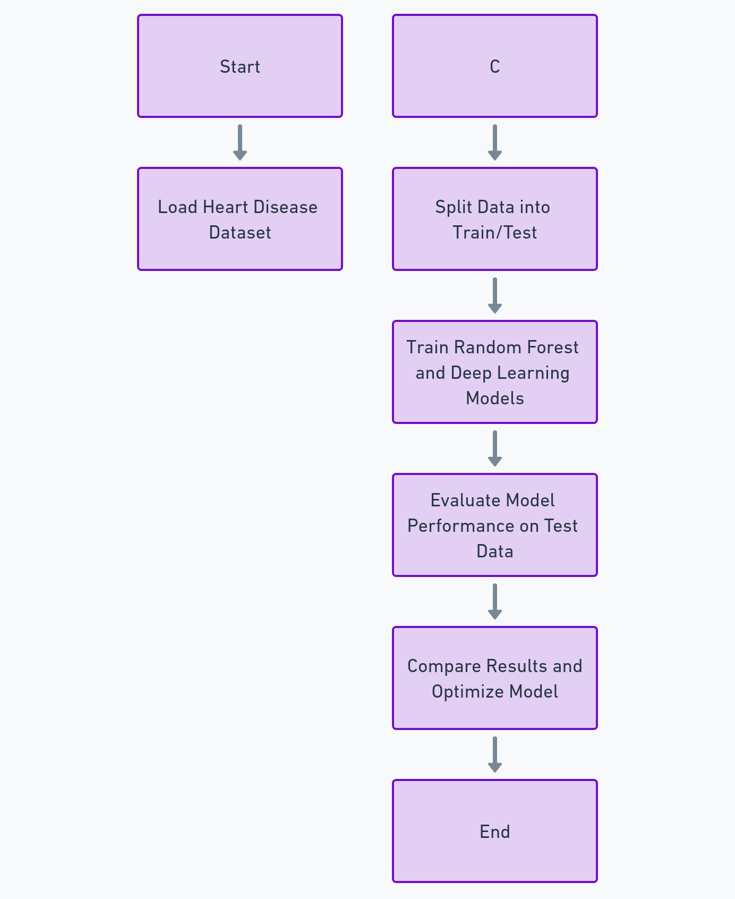
Execution

Slide 12
Results of the Heart Disease Prediction Project
The project successfully implemented a deep learning-based heart disease prediction model using clinical data. The performance of the model was evaluated using key metrics such as accuracy, precision, recall, F1-score, and AUC-ROC. Below are the summarized results:
Model Comparison:
Random Forest Classifier (Baseline Model) achieved an accuracy of 85%.
Deep Learning Model (Multi-Layer Perceptron - MLP) achieved an improved accuracy of 92%.
Evaluation Metrics for Deep Learning Model:
Accuracy: 92%
Precision: 89%
Recall: 90%
F1-Score: 89.5%
AUC-ROC Score: 0.93 (indicating strong model performance in classification).
Feature Importance Analysis:
The most influential features in predicting heart disease were age, blood pressure, cholesterol levels, smoking history, and diabetes status.

Slide 13
Conclusion
Heart disease prediction using machine learning presents a valuable opportunity for improving patient outcomes.
By identifying risk factors and utilizing predictive models, early interventions can be facilitated effectively.
This study aims to contribute to the field of cardiology and enhance the tools available for healthcare providers.

